Slide 1

Evaluating multiple classifiers for stock price direction prediction
Michel Ballings, Dirk Van den Poel, Nathalie Hespeels, Ruben Gryp
This Photo by Unknown author is licensed under CC BY-NC-ND.

Slide 2
Introduction
The authors of the paper dedicated an entire reserch to benchmark ensemble models (Random Forest, Adaboost and Kernel Factory) against single classifier models (Neural Networks, Logistic regression, Support Vector Machines and K-nearest Neighbors) in predicting stock market direction.
The objective of the study was to predict stock price direction one year ahead.
This is one of the first few studies to consider ensemble models in predicting stock prices and the author believed that ensemble models would perform better than single classifier models.

Slide 3
Ensemble models
Ensemble methods take a myriad of models into account, and average those models to produce one final model.
Types of Ensemble models
BAGGing, or Bootstrap AGGregating
Random Forest

Slide 4
Single classifier models
These models consider weights.
Types of single classifier models
Linear regression
Support Vector machines
Neural networks

Slide 5
Data Collection
For this research the authors used Amadeus Database to extract yearly financial information about 5767 European companies.
Based on previous literature work Ballings et al used only the most important predictors for their research.
Some of these important features are earnings yield, cash flow yield, book-to-market ratio, and size

Slide 6
Results
Area under the receiver operating characteristic curve (AUC) is used to measure the performance.
The results indicate that Random Forest is the top algorithm followed by Support Vector Machines, Kernel Factory, AdaBoost, Neural Networks, K-Nearest Neighbors and Logistic Regression.

Slide 7
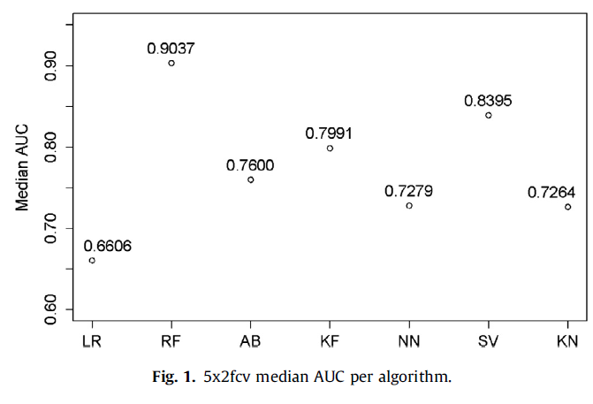
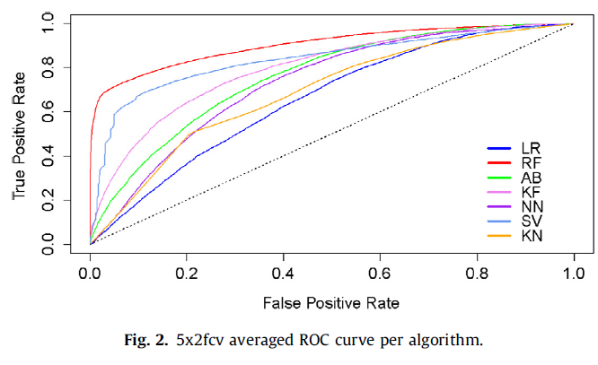
Results

Slide 8
Results
In AUC we can see that RF performed better than all other algorithms.
ROC curve shows us the generalizability of results.

Slide 9
Key Learnings
Ensemble models are better than single classifier models when predicting the direction of stocks not the exact stock prices.
AUC and ROC are a good way to differentiate between different models.
Random forest proved to be the best algorithm in finding direction of stocks.
Interquartile range (IQR), bigger the difference, bigger the deviation is and the lower the stability is.
Long term investors, apply buy and hold strategy because small changes in quotes are less important since their volumes are significantly smaller and trades are repeated less frequently.

Slide 10
Citation
[1] Ballings, M., Poel, D. V., Hespeels, N., & Gryp, R. (2015). Evaluating multiple classi-fiers for stock price direction prediction. Ex-pert Systems with Applications,42(20), 7046-7056. doi:10.1016/j.eswa.2015.05.013

Slide 11
Stock Market Prediction
Akash Sindhu, Tiago Benko, Lorena Silva

Slide 12
Introduction
Financial markets are highly volatile and generate huge amounts of data daily.
Stock prices are predicted to determine the future value of companies’ stock or other financial instruments that are marketed on financial exchanges.
However, the stock market is influenced by many factors such as political events, economic conditions and traders’ expectation.

Slide 13
Stock Market Analysis
Fundamental Analysis
Fundamental Analysis involves analyzing the company’s future profitability on the basis of its current business environment and financial performance.
Technical Analysis
Technical Analysis, on the other hand, includes reading the charts and using statistical figures to identify the trends in the stock market.

Slide 14
Existing methods
Moving Average
Linear Regression
Random Forest Regression
Auto ARIMA
Prophet
Long Short Term Memory (LSTM)

Slide 15
Data Collection
Sentiment Analysis
We took twitter sentiment analysis of last 100 tweets to see if the news is positive, negative or neutral about any company.

Slide 16


Data Collection
It provides global real time and historical data for daily, weekly, monthly and intraday.
We collected daily market data for 2941 companies dated from 2019-04-12 to the IPO date of the company
We developed a multi account data extraction algorithm that enable us to acquire API data at a faster pace while still using Alpha Vantage's free tier
https://github.com/tiagobka/HistoricalStockDataExtraction

Slide 17

Data Collection
news API
News API free tier can only get news articles within a period of 1 Month. The paid Tier Can give access to news articles for a 1 year period.

Slide 18

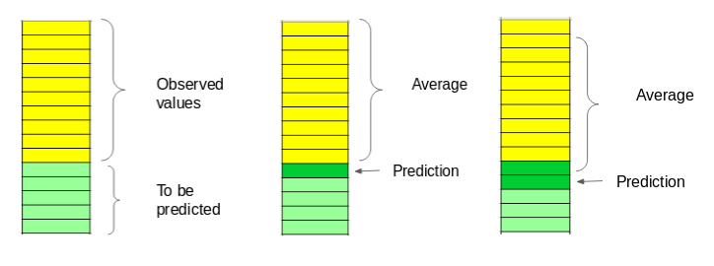
Moving Average
In each subsequent steps, the predicted values are taken into consideration while removing the oldest observed value from the set.

Slide 19
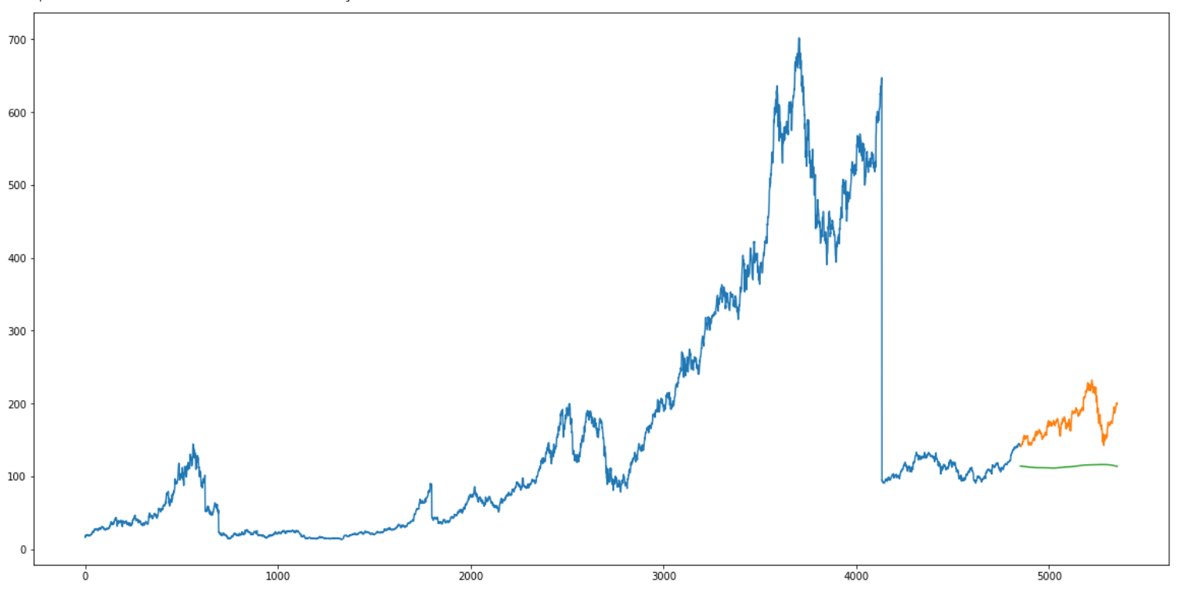
Moving Average Test Result
RMSE : 65.4649

Slide 20
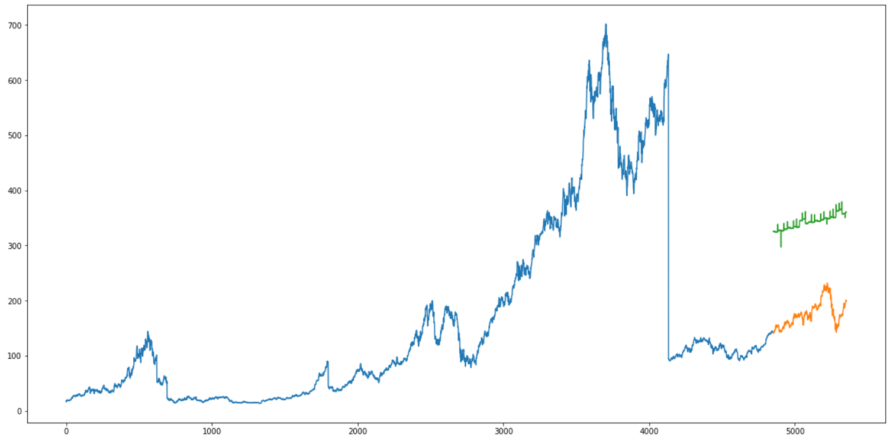
Linear Regression Test Result
RMSE: 168.21809

Slide 21
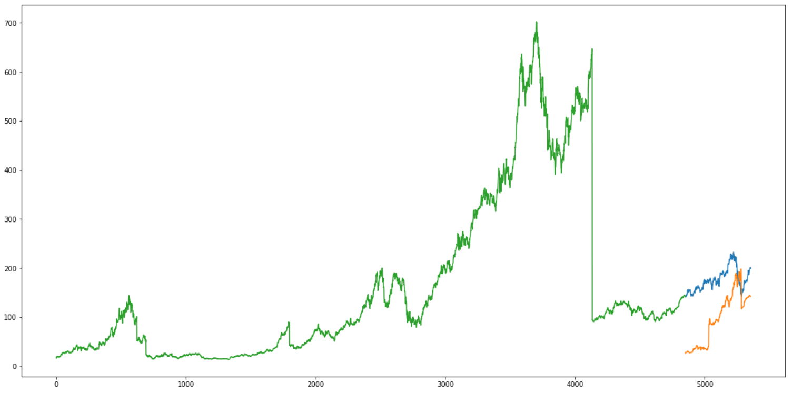
Random Forest Regressor Test Result
RMSE: 90.25008

Slide 22
AUTO ARIMA
ARIMA stands for Auto Regression Integrated Moving Average. It is a very popular statistical method for time series forecasting.
It takes three parameters:
p (past values used for forecasting the next value.)
q (past forecast errors used to predict the future values.)
d (order of differencing)

Slide 23
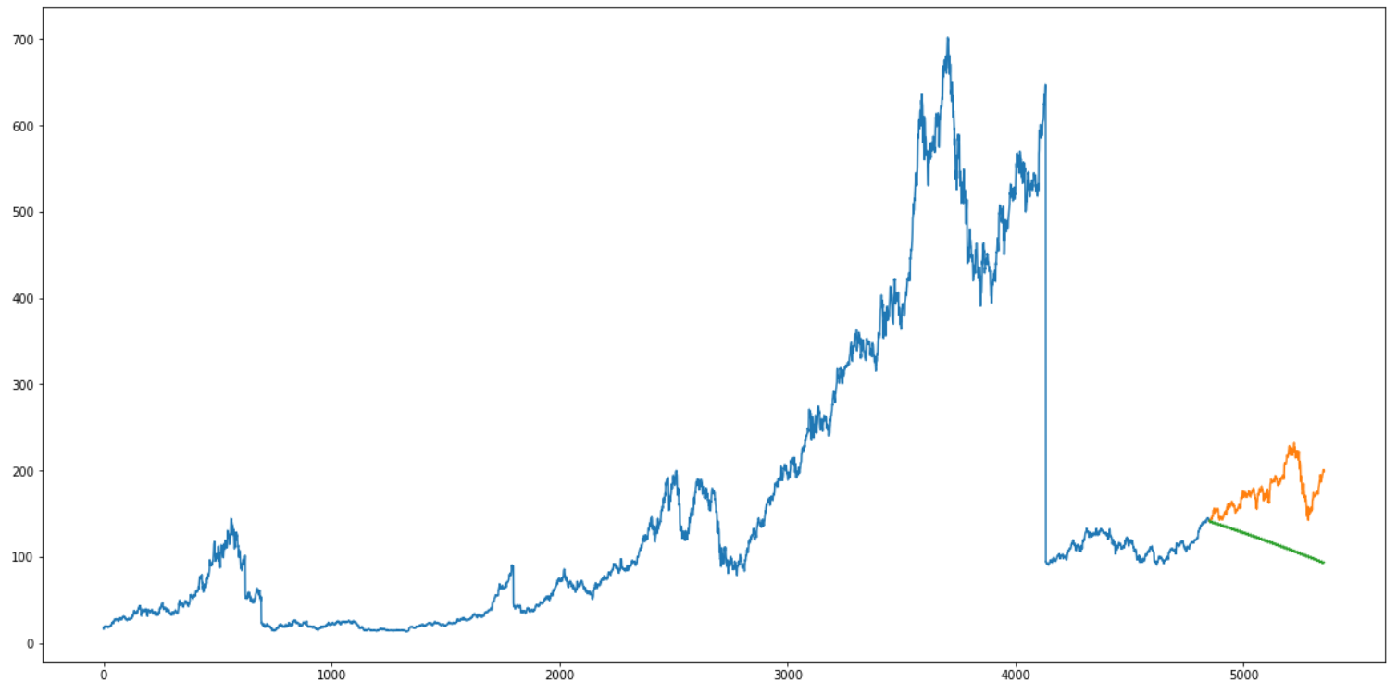
Auto ARIMA Test Results
RMSE: 66.180755

Slide 24
LSTM (Long Short Term Memory)
LSTMs are widely used for sequence prediction problems.
LSTM is able to store past information that is important, and forget the information that is not.
LSTM has three gates:
The input gate: The input gate adds information to the cell state
The forget gate: It removes the information that is no longer required by the model
The output gate: Output Gate at LSTM selects the information to be shown as output

Slide 25
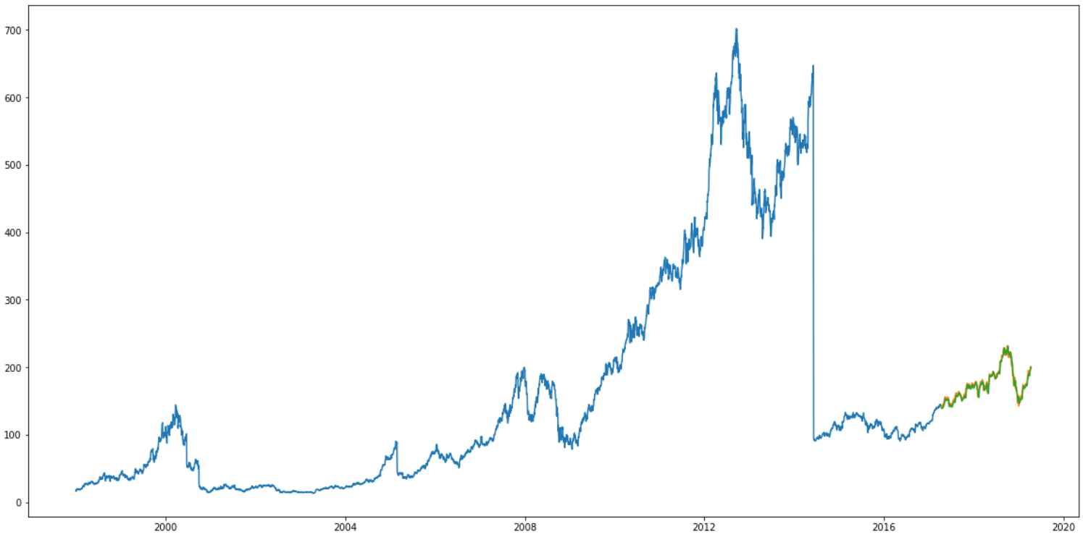
LSTM (Long Short Term Memory) Test Resut
RMSE: 4.21558

Slide 26

So, can we predict stock market?
This Photo by Unknown author is licensed under CC BY-NC-ND.

Slide 27
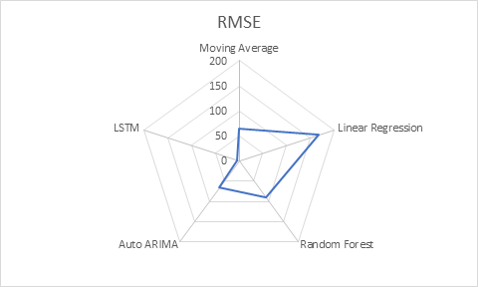
RMSE comparision

Slide 28
References
https://github.com/rhnvrm/labeled-tweet-generator
https://twitter-sentiment-csv.herokuapp.com/
https://www.analyticsvidhya.com/blog/2018/10/predicting-stock-price-machine-learningnd-deep-learning-techniques-python/#comment-156405

